Slide 1
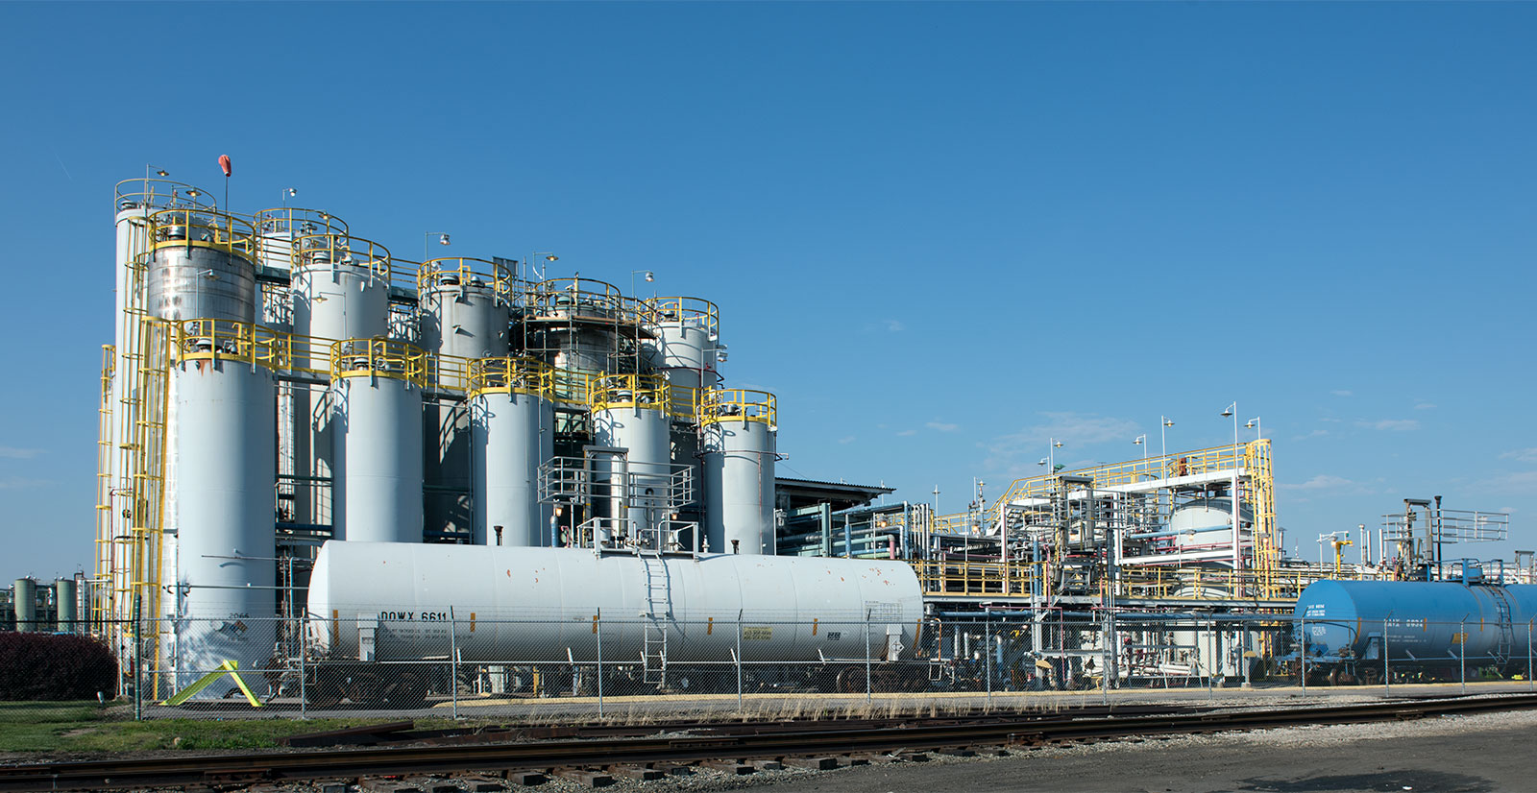

2015 – 2030
INDIA PPHP AND PPCP MARKET
FORECAST & OPPORTUNITIES
www.techsciresearch.com
MARKET INTELLIGENCE . CONSULTING

Slide 2
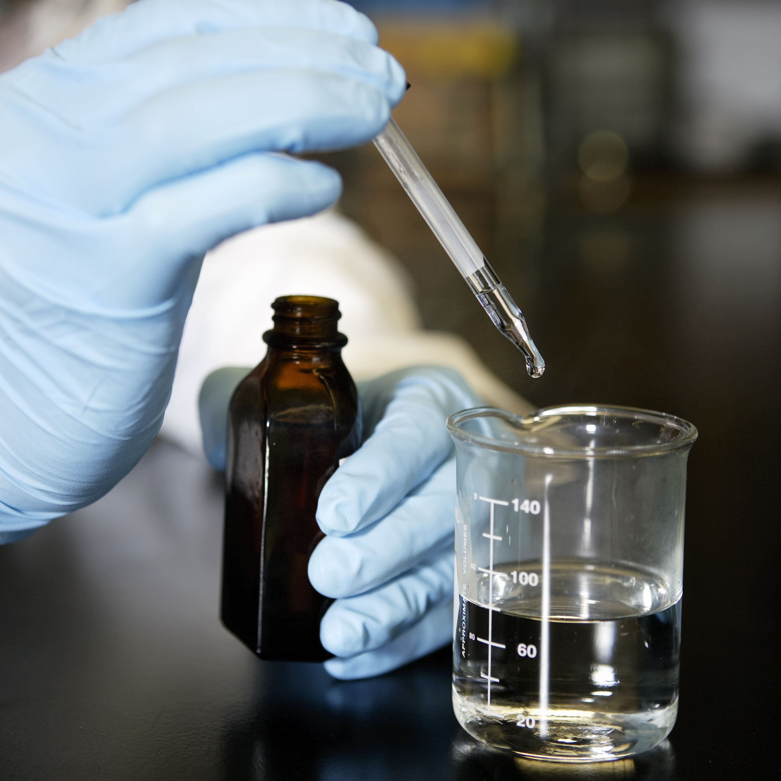
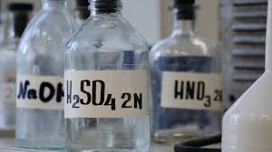
India PPHP & PPCP
Market Outlook

Slide 3
West India Polypropylene Capacity by Company, By Volume (Thousand Tonnes )
Table 1: West India Polypropylene Capacity, By Company, By Volume , 2015-2030F (Thousand Tonnes)
Company Name | Grade | Location | 2015 | 2020 | 2021 | 2022E | 2025F | 2030F
Reliance Industries Limited | PPHP and PPCP | Vadodara - Gujarat | 180 | 180 | 180 | 180 | 180 | 180
Reliance Industries Limited | PPHP and PPCP | Hazira - Gujarat | 440 | 440 | 440 | 440 | 440 | 440
Reliance Industries Limited | PPHP | Jamnagar - Gujarat | 2105 | 2105 | 2105 | 2105 | 2105 | 2105
Reliance Industries Limited | PPHP | Nagothane - Gujarat | 120 | 160 | 160 | 160 | 160 | 160
Indian Oil Corporation Limited | PPHP | Koyali - Gujarat | 0 | 0 | 0 | 0 | 500 | 500
ONGC Petro Additions Limited | PPHP and PPCP | Dahej - Gujarat | 0 | 340 | 340 | 340 | 340 | 340
Nayara Energy Limited | PPHP | Vadinar –Gujarat | 0 | 0 | 0 | 0 | 450 | 450
GAIL (India) Limited | PPHP | Usar - Maharashtra | 0 | 0 | 0 | 0 | 0 | 500

Slide 4
North India Polypropylene Capacity by Company, By Volume (Thousand Tonnes )
Table 1: North India Polypropylene Capacity, By Company, By Volume , 2015-2030F (Thousand Tonnes)
Company Name | Grade | Location | 2015 | 2020 | 2021 | 2022E | 2025F | 2030F
Indian Oil Corporation Limited | PPHP and PPCP | Panipat - Haryana | 600 | 600 | 760 | 760 | 760 | 760
HPCL-Mittal Energy Limited | PPHP and PPCP | Bathinda – Punjab | 440 | 467 | 467 | 967 | 967 | 967
GAIL (India) Limited | PPHP and PPCP | Pata – Uttar Pradesh | 0 | 0 | 0 | 0 | 60 | 60

Slide 5
South India Polypropylene Capacity by Company, By Volume (Thousand Tonnes )
Table 1: South India Polypropylene Capacity, By Company, By Volume , 2015-2030F (Thousand Tonnes)
Company Name | Grade | Location | 2015 | 2020 | 2021 | 2022E | 2025F | 2030F
Mangalore Refinery & Petrochemicals Ltd | PPHP | Mangalore - Karnataka | 0 | 440 | 440 | 440 | 440 | 440

Slide 6
East India Polypropylene Capacity by Company, By Volume (Thousand Tonnes )
Table 1: East India Polypropylene Capacity, By Company, By Volume , 2015-2030F (Thousand Tonnes)
Company Name | Grade | Location | 2015 | 2020 | 2021 | 2022E | 2025F | 2030F
Indian Oil Corporation Limited | PPHP | Paradip – Odissa | 0 | 700 | 700 | 700 | 700 | 700
Indian Oil Corporation Limited | PPHP | Barauni - Bihar | 0 | 0 | 0 | 0 | 200 | 200
Haldia Petrochemicals Limited | PPHP and PPCP | Haldia – West Bengal | 330 | 360 | 360 | 360 | 360 | 360
Brahmaputra Cracker and Polymers Limited | PPHP | Dibrugarh - Assam | 60 | 60 | 60 | 60 | 60 | 60

Slide 7
West India Polypropylene Production by Company, By Volume (Thousand Tonnes )
Table 1: West India Polypropylene Production, By Company, By Volume , 2015-2030F (Thousand Tonnes)
Company Name | Grade | Location | 2015 | 2020 | 2021 | 2022E | 2025F | 2030F
Reliance Industries Limited | PPHP and PPCP | Vadodara - Gujarat | 171.114 | 174.876 | 175.254 | 172.878 | 180 | 180
Reliance Industries Limited | PPHP and PPCP | Hazira - Gujarat | 418.583 | 427.779 | 428.703 | 422.895 | 440 | 440
Reliance Industries Limited | PPHP | Jamnagar - Gujarat | 2038.9 | 2084.37 | 2087.11 | 2059.32 | 2105 | 2105
Reliance Industries Limited | PPHP | Nagothane - Gujarat | 116.46 | 157.024 | 158.96 | 156.848 | 160 | 160
Indian Oil Corporation Limited | PPHP | Koyali - Gujarat | 0 | 0 | 0 | 0 | 150 | 390
ONGC Petro Additions Limited | PPHP and PPCP | Dahej - Gujarat | 0 | 315 | 313 | 308 | 320 | 333
Nayara Energy Limited | PPHP | Vadinar –Gujarat | 0 | 0 | 0 | 0 | 250 | 400
GAIL (India) Limited | PPHP | Usar - Maharashtra | 0 | 0 | 0 | 0 | 0 | 425

Slide 8
North India Polypropylene Production by Company, By Volume (Thousand Tonnes )
Table 1: North India Polypropylene Production, By Company, By Volume , 2015-2030F (Thousand Tonnes)
Company Name | Grade | Location | 2015 | 2020 | 2021 | 2022E | 2025F | 2030F
Indian Oil Corporation Limited | PPHP and PPCP | Panipat - Haryana | 625 | 580 | 582 | 591 | 707 | 718
HPCL-Mittal Energy Limited | PPHP and PPCP | Bathinda – Punjab | 324 | 445 | 441 | 890 | 909 | 948
GAIL (India) Limited | PPHP and PPCP | Pata – Uttar Pradesh | 0 | 0 | 0 | 0 | 30 | 51

Slide 9
South India Polypropylene Production by Company, By Volume (Thousand Tonnes )
Table 1: South India Polypropylene Production, By Company, By Volume , 2015-2030F (Thousand Tonnes)
Company Name | Grade | Location | 2015 |  | 2020 | 2021 | 2022E | 2025F | 2030F
Mangalore Refinery & Petrochemicals Ltd | PPHP | Mangalore - Karnataka | 0 | 424.996 | 409.992 | 405.108 | 397.892 | 413.6 | 431.2

Slide 10
East India Polypropylene Production by Company, By Volume (Thousand Tonnes )
Table 1: East India Polypropylene Production, By Company, By Volume , 2015-2030F (Thousand Tonnes)
Company Name | Grade | Location | 2015 | 2020 | 2021 | 2022E | 2025F | 2030F
Indian Oil Corporation Limited | PPHP | Paradip – Odissa | 0 | 282 | 390 | 388 | 582 | 676
Indian Oil Corporation Limited | PPHP | Barauni - Bihar | 0 | 0 | 0 | 0 | 30 | 160
Haldia Petrochemicals Limited | PPHP and PPCP | Haldia – West Bengal | 77 | 363 | 333 | 359 | 414 | 431
Brahmaputra Cracker and Polymers Limited | PPHP | Dibrugarh - Assam | 0 | 138 | 134 | 130 | 144 | 157

Slide 11
Polypropylene Demand By Region
Table 1: India Polypropylene Homopolymer Demand, By Region, By Volume, 2015-2030F (Thousand Tonnes)
 | 2015 | 2020 | 2021 | 2022E | 2023E | 2024E | 2025F | 2026F | 2027F | 2028F | 2029F | 2030F
West | 2361 | 2964 | 2759 | 2756 | 2996 | 3264 | 3544 | 3843 | 4159 | 4494 | 4848 | 5211
North | 903 | 1125 | 1048 | 1454 | 1581 | 1722 | 1870 | 2028 | 2195 | 2372 | 2558 | 2750
South | 26 | 439 | 410 | 384 | 417 | 454 | 493 | 535 | 579 | 626 | 675 | 725
East | 37 | 642 | 690 | 712 | 774 | 844 | 916 | 993 | 1075 | 1162 | 1253 | 1347
Table 2: India Polypropylene Copolymer Demand, By Region, By Volume, 2015-2030F (Thousand Tonnes)
 | 2015 | 2020 | 2021 | 2022E | 2023E | 2024E | 2025F | 2026F | 2027F | 2028F | 2029F | 2030F
West | 338 | 475 | 448 | 469 | 508 | 548 | 591 | 637 | 686 | 737 | 791 | 847
North | 204 | 340 | 341 | 370 | 407 | 444 | 482 | 522 | 565 | 610 | 657 | 707
South | 169 | 258 | 247 | 279 | 310 | 340 | 370 | 404 | 439 | 477 | 517 | 560
East | 29 | 39 | 34 | 39 | 48 | 55 | 58 | 61 | 64 | 67 | 70 | 73

Slide 12
Polypropylene Homopolymer Demand Supply Gap Analysis
Table 1: North India Polypropylene Homopolymer Demand Supply Gap, By Volume, 2015-2030F (Thousand Tonnes)
 | 2015 | 2020 | 2021 | 2022E | 2023E | 2024E | 2025F | 2026F | 2027F | 2028F | 2029F | 2030F
Production | 834 | 858 | 850 | 1275 | 1272 | 1323 | 1411 | 1410 | 1406 | 1451 | 1461 | 1468
Total Demand | 704 | 1043 | 982 | 1057 | 1148 | 1247 | 1349 | 1459 | 1572 | 1692 | 1819 | 1949
Demand Supply Gap |  |  |  | 217 | 123 | 76 | 62 | -49 | -166 | -241 | -358 | -481
Table 2: South India Polypropylene Homopolymer Market Supply Analysis, By Volume, 2015-2030F (Thousand Tonnes)
 | 2015 | 2020 | 2021 | 2022E | 2023E | 2024E | 2025F | 2026F | 2027F | 2028F | 2029F | 2030F
Production | 834 | 858 | 850 | 1275 | 1272 | 1323 | 1411 | 1410 | 1406 | 1451 | 1461 | 1468
Total Demand
Demand Supply Gap

Slide 13
India Polypropylene Homopolymer Market Share, By Top 3 States
Figure 2: West India Polypropylene Homopolymer Market Share, By Top 3 States, By Volume (Thousand Tonnes), 2015–2030F
Others include Goa, Daman & Diu, etc
Source: TechSci Research
Figure 2: North India Polypropylene Homopolymer Market Share, By Top 3 States, By Volume (Thousand Tonnes), 2015–2030F
Others include Punjab, Uttarakhand, Himachal Pradesh, etc.
Source: TechSci Research
Year depicts the fiscal year ending in the month of March of that year.
2020 – April 2019-March 2020

Slide 14
India Polypropylene Homopolymer Market Share, By Top 3 States
Figure 2: South India Polypropylene Homopolymer Market Share, By Top 3 States, By Volume (Thousand Tonnes), 2015–2030F
Others include Kerala, Karnataka, etc
Source: TechSci Research
Figure 2: East India Polypropylene Homopolymer Market Share, By Top 3 States, By Volume (Thousand Tonnes), 2015–2030F
Others include Assam, Bihar and Chattisgarh, etc.
Source: TechSci Research
Year depicts the fiscal year ending in the month of March of that year.
2020 – April 2019-March 2020

Slide 15
India Polypropylene Copolymer Market Share, By Top 3 States
Figure 2: West India Polypropylene Copolymer Market Share, By Top 3 States, By Volume (Thousand Tonnes), 2015–2030F
Others include Goa, Daman & Diu, etc
Source: TechSci Research
Figure 2: North India Polypropylene Copolymer Market Share, By Top 3 States, By Volume (Thousand Tonnes), 2015–2030F
Others include Punjab, Uttarakhand, Himachal Pradesh, etc.
Source: TechSci Research
Year depicts the fiscal year ending in the month of March of that year.
2020 – April 2019-March 2020

Slide 16
India Polypropylene Copolymer Market Share, By Top 3 States
Figure 2: South India Polypropylene Copolymer Market Share, By Top 3 States, By Volume (Thousand Tonnes), 2015–2030F
Others include Kerala, Karnataka, etc
Source: TechSci Research
Figure 2: East India Polypropylene Copolymer Market Share, By Top 3 States, By Volume (Thousand Tonnes), 2015–2030F
Others include Assam, Bihar and Chattisgarh, etc.
Source: TechSci Research
Year depicts the fiscal year ending in the month of March of that year.
2020 – April 2019-March 2020

Slide 17
India Polypropylene Homopolymer Market Share, By End Use
Figure 2: West India Polypropylene Homopolymer Market Share, By End Use, By Volume (Thousand Tonnes), 2015–2030F
Others include Goa, Daman & Diu, etc
Source: TechSci Research
Figure 2: North India Polypropylene Homopolymer Market Share, By End Use, By Volume (Thousand Tonnes), 2015–2030F
Others include Punjab, Uttarakhand, Himachal Pradesh, etc.
Source: TechSci Research
Year depicts the fiscal year ending in the month of March of that year.
2020 – April 2019-March 2020

Slide 18
India Polypropylene Homopolymer Market Share, By End Use
Figure 2: South India Polypropylene Homopolymer Market Share, By End Use, By Volume (Thousand Tonnes), 2015–2030F
Others include Kerala, Karnataka, etc
Source: TechSci Research
Figure 2: East India Polypropylene Homopolymer Market Share, By End Use, By Volume (Thousand Tonnes), 2015–2030F
Others include Assam, Bihar and Chattisgarh, etc.
Source: TechSci Research
Year depicts the fiscal year ending in the month of March of that year.
2020 – April 2019-March 2020

Slide 19
India Polypropylene Copolymer Market Share, By End Use
Figure 2: West India Polypropylene Copolymer Market Share, By End Use, By Volume (Thousand Tonnes), 2015–2030F
Others include Goa, Daman & Diu, etc
Source: TechSci Research
Figure 2: North India Polypropylene Copolymer Market Share, By End Use, By Volume (Thousand Tonnes), 2015–2030F
Others include Punjab, Uttarakhand, Himachal Pradesh, etc.
Source: TechSci Research
Year depicts the fiscal year ending in the month of March of that year.
2020 – April 2019-March 2020

Slide 20
India Polypropylene Copolymer Market Share, By End Use
Figure 2: South India Polypropylene Copolymer Market Share, By End Use, By Volume (Thousand Tonnes), 2015–2030F
Others include Kerala, Karnataka, etc
Source: TechSci Research
Figure 2: East India Polypropylene Copolymer Market Share, By End Use, By Volume (Thousand Tonnes), 2015–2030F
Year depicts the fiscal year ending in the month of March of that year.
2020 – April 2019-March 2020
Others include Assam, Bihar and Chattisgarh, etc.
Source: TechSci Research

Slide 21
India Polypropylene Homopolymer Market Share, By Grade
Figure 2: West India Polypropylene Homopolymer Market Share, By Grade, By Volume (Thousand Tonnes), 2015–2030F
Others include Goa, Daman & Diu, etc
Source: TechSci Research
Figure 2: North India Polypropylene Homopolymer Market Share, By Grade, By Volume (Thousand Tonnes), 2015–2030F
Others include Punjab, Uttarakhand, Himachal Pradesh, etc.
Source: TechSci Research
Year depicts the fiscal year ending in the month of March of that year.
2020 – April 2019-March 2020

Slide 22
India Polypropylene Homopolymer Market Share, By Grade
Figure 2: South India Polypropylene Homopolymer Market Share, By Grade, By Volume (Thousand Tonnes), 2015–2030F
Others include Kerala, Karnataka, etc
Source: TechSci Research
Figure 2: East India Polypropylene Homopolymer Market Share, By Grade, By Volume (Thousand Tonnes), 2015–2030F
Others include Assam, Bihar and Chattisgarh, etc.
Source: TechSci Research
Year depicts the fiscal year ending in the month of March of that year.
2020 – April 2019-March 2020

Slide 23
India Polypropylene Copolymer Market Share, By Grade
Figure 2: West India Polypropylene Copolymer Market Share, By Grade, By Volume (Thousand Tonnes), 2015–2030F
Others include Goa, Daman & Diu, etc
Source: TechSci Research
Figure 2: North India Polypropylene Copolymer Market Share, By Grade, By Volume (Thousand Tonnes), 2015–2030F
Others include Punjab, Uttarakhand, Himachal Pradesh, etc.
Source: TechSci Research
Year depicts the fiscal year ending in the month of March of that year.
2020 – April 2019-March 2020

Slide 24
India Polypropylene Copolymer Market Share, By Grade
Figure 2: South India Polypropylene Copolymer Market Share, By Grade By Volume (Thousand Tonnes), 2015–2030F
Others include Kerala, Karnataka, etc
Source: TechSci Research
Figure 2: East India Polypropylene Copolymer Market Share, By Grade, By Volume (Thousand Tonnes), 2015–2030F
Year depicts the fiscal year ending in the month of March of that year.
2020 – April 2019-March 2020
Others include Assam, Bihar and Chattisgarh, etc.
Source: TechSci Research

Slide 25
North India Polypropylene Homopolymer Demand Supply Gap Graph
Figure 2: North India Polypropylene Homopolymer Demand Supply Gap Graph, By Volume (Thousand Tonnes), 2021E–2030F
Year depicts the fiscal year ending in the month of March of that year.
2020 – April 2019-March 2020

Slide 26
North India Polypropylene Homopolymer Market Share, By Application
Figure 3: North India Polypropylene Homopolymer Market Share, By Application, By Volume (Thousand Tonnes), 2015–2030F
Others include Storage Batteries, Synthetic Gypsum, Mineral Leaching , TDI/ Nitric Acid/ Aniline/ p-Cresol, Zinc sulphate etc
Source: TechSci Research
FY depicts the fiscal year ending in the month of March of that year.
FY2020 – April 2019-March 2020

Slide 27
North India Polypropylene Homopolymer Market Share, By Process
Figure 4: North India Polypropylene Homopolymer Market Share, By Process, By Volume (Thousand Tonnes), 2015–2030F
Others include Storage Batteries, Synthetic Gypsum, Mineral Leaching , TDI/ Nitric Acid/ Aniline/ p-Cresol, Zinc sulphate etc
Source: TechSci Research
FY depicts the fiscal year ending in the month of March of that year.
FY2020 – April 2019-March 2020

Slide 28
East India Polypropylene Homopolymer Demand Supply Gap Analysis
Table 2: East India Polypropylene Homopolymer Market Supply Analysis, By Volume, 2015-2030F (Thousand Tonnes)
 | 2015 | 2016 | 2017 | 2018 | 2019 | 2020 | 2021 | 2022E | 2025F | 2026F | 2027F | 2028F | 2029F | 2030F
Capacity | 350 | 380 | 380 | 380 | 380 | 1080 | 1080 | 1080 | 1280 | 1280 | 1280 | 1280 | 1280 | 1280
Production | 78 | 317 | 303 | 324 | 367 | 631 | 708 | 731 | 967 | 996 | 1032 | 1068 | 1142 | 1208
Operating Rate | 77.15% | 80.88% | 79.94% | 83.71% | 81.11% | 81.27% | 75.19% |  | 84.62% | 85.00% | 87.00% | 88.00% | 89.00% | 90.00%
Import | 862.32 | 1388.79 | 1300.29 | 946.55 | 1477.94 | 1986.61
Export | 60.55 | 37.09 | 172.01 | 394.47 | 124.74 | 51.38
Total Demand | 12215.97 | 13317.97 | 13278.87 | 13610.55 | 14250.35 | 15020.24 | 13856.32 |  | 17569.87 | 18467.69 | 19400.31 | 20360.63 | 21339.97 | 22381.36
Demand Supply Gap |  |  |  |  |  |  | -1750.69 |  | -3946.02 | -4782.69 | -5393.31 | -6192.63 | -7010.97 | -7891.36
Demand = Production + Import – Export
Demand Supply Gap = Production – Demand
Source: TechSci Research

Slide 29
East India Polypropylene Homopolymer Market Share, By Top 3 States
Figure 5: East India Sulphuric Acid Market Share, By Top 3 States, By Volume (Thousand Tonnes), 2015–2030F
Year depicts the fiscal year ending in the month of March of that year.
2020 – April 2019-March 2020

Slide 30
East India Polypropylene Homopolymer Demand Supply Gap Graph
Figure 6: East India Polypropylene Homopolymer Demand Supply Gap Graph, By Volume (Thousand Tonnes), 2021E–2030F
Year depicts the fiscal year ending in the month of March of that year.
2020 – April 2019-March 2020

Slide 31
East India Polypropylene Homopolymer Market Share, By Application
Figure 7: East India Polypropylene Homopolymer Market Share, By Application, By Volume (Thousand Tonnes), 2015–2030F
Others include Storage Batteries, Synthetic Gypsum, Mineral Leaching , TDI/ Nitric Acid/ Aniline/ p-Cresol, Zinc sulphate etc
Source: TechSci Research
FY depicts the fiscal year ending in the month of March of that year.
FY2020 – April 2019-March 2020

Slide 32
East India Polypropylene Homopolymer Market Share, By Process
Figure 8: East India Polypropylene Homopolymer Market Share, By Process, By Volume (Thousand Tonnes), 2015–2030F
Others include Storage Batteries, Synthetic Gypsum, Mineral Leaching , TDI/ Nitric Acid/ Aniline/ p-Cresol, Zinc sulphate etc
Source: TechSci Research
FY depicts the fiscal year ending in the month of March of that year.
FY2020 – April 2019-March 2020

Slide 33
West India Polypropylene Homopolymer Demand Supply Gap Analysis
Table 3: West India Polypropylene Homopolymer Market Supply Analysis, By Volume, 2015-2030F (Thousand Tonnes)
 | 2015 | 2016 | 2017 | 2018 | 2019 | 2020 | 2021 | 2022E | 2025F | 2026F | 2027F | 2028F | 2029F | 2030F
Capacity | 2755 | 2755 | 3085 | 3085 | 3085 | 3085 | 3085 | 3085 | 4035 | 4535 | 4535 | 4535 | 4535 | 4535
Production | 2659 | 2716 | 2638 | 2958 | 3049 | 3027 | 3032 | 2988 | 3443 | 3758 | 3853 | 4056 | 4167 | 4254
Operating Rate | 77.15% | 80.88% | 79.94% | 83.71% | 81.11% | 81.27% | 75.19% |  | 84.62% | 85.00% | 87.00% | 88.00% | 89.00% | 90.00%
Import | 862.32 | 1388.79 | 1300.29 | 946.55 | 1477.94 | 1986.61
Export | 60.55 | 37.09 | 172.01 | 394.47 | 124.74 | 51.38
Total Demand | 12215.97 | 13317.97 | 13278.87 | 13610.55 | 14250.35 | 15020.24 | 13856.32 |  | 17569.87 | 18467.69 | 19400.31 | 20360.63 | 21339.97 | 22381.36
Demand Supply Gap |  |  |  |  |  |  | -1750.69 |  | -3946.02 | -4782.69 | -5393.31 | -6192.63 | -7010.97 | -7891.36
Demand = Production + Import – Export
Demand Supply Gap = Production – Demand
Source: TechSci Research

Slide 34
West India Polypropylene Homopolymer Market Share, By Top 3 States
Figure 9: West India Sulphuric Acid Market Share, By Top 3 States, By Volume (Thousand Tonnes), 2015–2030F
Others include Goa, Daman & Diu, etc
Source: TechSci Research
Year depicts the fiscal year ending in the month of March of that year.
2020 – April 2019-March 2020

Slide 35
West India Polypropylene Homopolymer Demand Supply Gap Graph
Figure 10: West India Polypropylene Homopolymer Demand Supply Gap Graph, By Volume (Thousand Tonnes), 2021E–2030F
Year depicts the fiscal year ending in the month of March of that year.
2020 – April 2019-March 2020

Slide 36
West India Polypropylene Homopolymer Market Share, By Application
Figure 11: West India Polypropylene Homopolymer Market Share, By Application, By Volume (Thousand Tonnes), 2015–2030F
Others include Storage Batteries, Synthetic Gypsum, Mineral Leaching , TDI/ Nitric Acid/ Aniline/ p-Cresol, Zinc sulphate etc
Source: TechSci Research
FY depicts the fiscal year ending in the month of March of that year.
FY2020 – April 2019-March 2020

Slide 37
West India Polypropylene Homopolymer Market Share, By Process
Figure 12: West India Polypropylene Homopolymer Market Share, By Process, By Volume (Thousand Tonnes), 2015–2030F
Others include Storage Batteries, Synthetic Gypsum, Mineral Leaching , TDI/ Nitric Acid/ Aniline/ p-Cresol, Zinc sulphate etc
Source: TechSci Research
FY depicts the fiscal year ending in the month of March of that year.
FY2020 – April 2019-March 2020

Slide 38
South India Polypropylene Homopolymer Demand Supply Gap Analysis
Table 4: South India Polypropylene Homopolymer Market Supply Analysis, By Volume, 2015-2030F (Thousand Tonnes)
 | 2015 | 2016 | 2017 | 2018 | 2019 | 2020 | 2021 | 2022E | 2025F | 2026F | 2027F | 2028F | 2029F | 2030F
Capacity | 0 | 440 | 440 | 440 | 440 | 440 | 440 | 440 | 440 | 440 | 440 | 440 | 440 | 440
Production | 0 | 85 | 257 | 350 | 425 | 410 | 405 | 398 | 414 | 418 | 418 | 431 | 431 | 431
Operating Rate | 77.15% | 80.88% | 79.94% | 83.71% | 81.11% | 81.27% | 75.19% |  | 84.62% | 85.00% | 87.00% | 88.00% | 89.00% | 90.00%
Import | 862.32 | 1388.79 | 1300.29 | 946.55 | 1477.94 | 1986.61
Export | 60.55 | 37.09 | 172.01 | 394.47 | 124.74 | 51.38
Total Demand | 12215.97 | 13317.97 | 13278.87 | 13610.55 | 14250.35 | 15020.24 | 13856.32 |  | 17569.87 | 18467.69 | 19400.31 | 20360.63 | 21339.97 | 22381.36
Demand Supply Gap |  |  |  |  |  |  | -1750.69 |  | -3946.02 | -4782.69 | -5393.31 | -6192.63 | -7010.97 | -7891.36
Demand = Production + Import – Export
Demand Supply Gap = Production – Demand
Source: TechSci Research

Slide 39
South India Polypropylene Homopolymer Market Share, By Top 3 States
Figure 13: South India Sulphuric Acid Market Share, By Top 3 States, By Volume (Thousand Tonnes), 2015–2030F
Others include Kerala, Karnataka, etc
Source: TechSci Research
Year depicts the fiscal year ending in the month of March of that year.
2020 – April 2019-March 2020

Slide 40
South India Polypropylene Homopolymer Demand Supply Gap Graph
Figure 14: South India Polypropylene Homopolymer Demand Supply Gap Graph, By Volume (Thousand Tonnes), 2021E–2030F
Year depicts the fiscal year ending in the month of March of that year.
2020 – April 2019-March 2020

Slide 41
South India Polypropylene Homopolymer Market Share, By Application
Figure 15: South India Polypropylene Homopolymer Market Share, By Application, By Volume (Thousand Tonnes), 2015–2030F
Others include Storage Batteries, Synthetic Gypsum, Mineral Leaching , TDI/ Nitric Acid/ Aniline/ p-Cresol, Zinc sulphate etc
Source: TechSci Research
FY depicts the fiscal year ending in the month of March of that year.
FY2020 – April 2019-March 2020

Slide 42
South India Polypropylene Homopolymer Market Share, By Process
Figure 16: South India Polypropylene Homopolymer Market Share, By Process, By Volume (Thousand Tonnes), 2015–2030F
Others include Storage Batteries, Synthetic Gypsum, Mineral Leaching , TDI/ Nitric Acid/ Aniline/ p-Cresol, Zinc sulphate etc
Source: TechSci Research
FY depicts the fiscal year ending in the month of March of that year.
FY2020 – April 2019-March 2020

Slide 43
North India Polypropylene Copolymer Demand Supply Gap Analysis
Table 5: North India Polypropylene Copolymer Market Supply Analysis, By Volume, 2015-2030F (Thousand Tonnes)
 | 2015 | 2016 | 2017 | 2018 | 2019 | 2020 | 2021 | 2022E | 2025F | 2026F | 2027F | 2028F | 2029F | 2030F
Capacity | 60 | 60 | 60 | 60 | 60 | 60 | 76 | 126 | 126 | 126 | 126 | 126 | 126 | 126
Production | 62 | 59 | 59 | 58 | 59 | 57 | 55 | 97 | 104 | 105 | 105 | 110 | 114 | 117
Operating Rate | 77.15% | 80.88% | 79.94% | 83.71% | 81.11% | 81.27% | 75.19% |  | 84.62% | 85.00% | 87.00% | 88.00% | 89.00% | 90.00%
Import | 862.32 | 1388.79 | 1300.29 | 946.55 | 1477.94 | 1986.61
Export | 60.55 | 37.09 | 172.01 | 394.47 | 124.74 | 51.38
Total Demand | 12215.97 | 13317.97 | 13278.87 | 13610.55 | 14250.35 | 15020.24 | 13856.32 |  | 17569.87 | 18467.69 | 19400.31 | 20360.63 | 21339.97 | 22381.36
Demand Supply Gap |  |  |  |  |  |  | -1750.69 |  | -3946.02 | -4782.69 | -5393.31 | -6192.63 | -7010.97 | -7891.36
Demand = Production + Import – Export
Demand Supply Gap = Production – Demand
Source: TechSci Research

Slide 44
North India Polypropylene Copolymer Market Share, By Top 3 States
Figure 17: North India Polypropylene Copolymer Market Share, By Top 3 States, By Volume (Thousand Tonnes), 2015–2030F
Others include Punjab, Uttarakhand, Himachal Pradesh, etc.
Source: TechSci Research
Year depicts the fiscal year ending in the month of March of that year.
2020 – April 2019-March 2020

Slide 45
North India Polypropylene Copolymer Demand Supply Gap Graph
Figure 18: North India Polypropylene Copolymer Demand Supply Gap Graph, By Volume (Thousand Tonnes), 2021E–2030F
Year depicts the fiscal year ending in the month of March of that year.
2020 – April 2019-March 2020

Slide 46
North India Polypropylene Copolymer Market Share, By Application
Figure 19: North India Polypropylene Copolymer Market Share, By Application, By Volume (Thousand Tonnes), 2015–2030F
Others include Storage Batteries, Synthetic Gypsum, Mineral Leaching , TDI/ Nitric Acid/ Aniline/ p-Cresol, Zinc sulphate etc
Source: TechSci Research
FY depicts the fiscal year ending in the month of March of that year.
FY2020 – April 2019-March 2020

Slide 47
North India Polypropylene Copolymer Market Share, By Process
Figure 20: North India Polypropylene Copolymer Market Share, By Process, By Volume (Thousand Tonnes), 2015–2030F
Others include Storage Batteries, Synthetic Gypsum, Mineral Leaching , TDI/ Nitric Acid/ Aniline/ p-Cresol, Zinc sulphate etc
Source: TechSci Research
FY depicts the fiscal year ending in the month of March of that year.
FY2020 – April 2019-March 2020

Slide 48
East India Polypropylene Copolymer Demand Supply Gap Analysis
Table 6: East India Polypropylene Copolymer Market Supply Analysis, By Volume, 2015-2030F (Thousand Tonnes)
 | 2015 | 2016 | 2017 | 2018 | 2019 | 2020 | 2021 | 2022E | 2025F | 2026F | 2027F | 2028F | 2029F | 2030F
Capacity | 40 | 40 | 40 | 40 | 40 | 40 | 40 | 40 | 40 | 40 | 40 | 40 | 40 | 40
Production | 5 | 28 | 26 | 25 | 30 | 31 | 29 | 30 | 38 | 38 | 38 | 39 | 39 | 39
Operating Rate | 77.15% | 80.88% | 79.94% | 83.71% | 81.11% | 81.27% | 75.19% |  | 84.62% | 85.00% | 87.00% | 88.00% | 89.00% | 90.00%
Import | 862.32 | 1388.79 | 1300.29 | 946.55 | 1477.94 | 1986.61
Export | 60.55 | 37.09 | 172.01 | 394.47 | 124.74 | 51.38
Total Demand | 12215.97 | 13317.97 | 13278.87 | 13610.55 | 14250.35 | 15020.24 | 13856.32 |  | 17569.87 | 18467.69 | 19400.31 | 20360.63 | 21339.97 | 22381.36
Demand Supply Gap |  |  |  |  |  |  | -1750.69 |  | -3946.02 | -4782.69 | -5393.31 | -6192.63 | -7010.97 | -7891.36
Demand = Production + Import – Export
Demand Supply Gap = Production – Demand
Source: TechSci Research

Slide 49
East India Polypropylene Copolymer Market Share, By Top 3 States
Figure 21: East India Polypropylene Copolymer Market Share, By Top 3 States, By Volume (Thousand Tonnes), 2015–2030F
Year depicts the fiscal year ending in the month of March of that year.
2020 – April 2019-March 2020

Slide 50
East India Polypropylene Copolymer Demand Supply Gap Graph
Figure 22: East India Polypropylene Copolymer Demand Supply Gap Graph, By Volume (Thousand Tonnes), 2021E–2030F
Year depicts the fiscal year ending in the month of March of that year.
2020 – April 2019-March 2020

Slide 51
East India Polypropylene Copolymer Market Share, By Application
Figure 23: East India Polypropylene Copolymer Market Share, By Application, By Volume (Thousand Tonnes), 2015–2030F
Others include Storage Batteries, Synthetic Gypsum, Mineral Leaching , TDI/ Nitric Acid/ Aniline/ p-Cresol, Zinc sulphate etc
Source: TechSci Research
FY depicts the fiscal year ending in the month of March of that year.
FY2020 – April 2019-March 2020

Slide 52
East India Polypropylene Copolymer Market Share, By Process
Figure 24: East India Polypropylene Copolymer Market Share, By Process, By Volume (Thousand Tonnes), 2015–2030F
Others include Storage Batteries, Synthetic Gypsum, Mineral Leaching , TDI/ Nitric Acid/ Aniline/ p-Cresol, Zinc sulphate etc
Source: TechSci Research
FY depicts the fiscal year ending in the month of March of that year.
FY2020 – April 2019-March 2020

Slide 53
West India Polypropylene Copolymer Demand Supply Gap Analysis
Table 7: West India Polypropylene Copolymer Market Supply Analysis, By Volume, 2015-2030F (Thousand Tonnes)
 | 2015 | 2016 | 2017 | 2018 | 2019 | 2020 | 2021 | 2022E | 2025F | 2026F | 2027F | 2028F | 2029F | 2030F
Capacity | 90 | 90 | 140 | 140 | 140 | 140 | 140 | 140 | 140 | 140 | 140 | 140 | 140 | 140
Production | 86 | 88 | 87 | 104 | 135 | 131 | 131 | 131 | 137 | 137 | 138 | 138 | 139 | 139
Operating Rate | 77.15% | 80.88% | 79.94% | 83.71% | 81.11% | 81.27% | 75.19% |  | 84.62% | 85.00% | 87.00% | 88.00% | 89.00% | 90.00%
Import | 862.32 | 1388.79 | 1300.29 | 946.55 | 1477.94 | 1986.61
Export | 60.55 | 37.09 | 172.01 | 394.47 | 124.74 | 51.38
Total Demand | 12215.97 | 13317.97 | 13278.87 | 13610.55 | 14250.35 | 15020.24 | 13856.32 |  | 17569.87 | 18467.69 | 19400.31 | 20360.63 | 21339.97 | 22381.36
Demand Supply Gap |  |  |  |  |  |  | -1750.69 |  | -3946.02 | -4782.69 | -5393.31 | -6192.63 | -7010.97 | -7891.36
Demand = Production + Import – Export
Demand Supply Gap = Production – Demand
Source: TechSci Research

Slide 54
West India Polypropylene Copolymer Market Share, By Top 3 States
Figure 25: West India Polypropylene Copolymer Market Share, By Top 3 States, By Volume (Thousand Tonnes), 2015–2030F
Others include Goa, Daman & Diu, etc
Source: TechSci Research
Year depicts the fiscal year ending in the month of March of that year.
2020 – April 2019-March 2020

Slide 55
West India Polypropylene Copolymer Demand Supply Gap Graph
Figure 26: West India Polypropylene Copolymer Demand Supply Gap Graph, By Volume (Thousand Tonnes), 2021E–2030F
Year depicts the fiscal year ending in the month of March of that year.
2020 – April 2019-March 2020

Slide 56
West India Polypropylene Copolymer Market Share, By Application
Figure 27: West India Polypropylene Copolymer Market Share, By Application, By Volume (Thousand Tonnes), 2015–2030F
Others include Storage Batteries, Synthetic Gypsum, Mineral Leaching , TDI/ Nitric Acid/ Aniline/ p-Cresol, Zinc sulphate etc
Source: TechSci Research
FY depicts the fiscal year ending in the month of March of that year.
FY2020 – April 2019-March 2020

Slide 57
West India Polypropylene Copolymer Market Share, By Process
Figure 28: West India Polypropylene Copolymer Market Share, By Process, By Volume (Thousand Tonnes), 2015–2030F
Others include Storage Batteries, Synthetic Gypsum, Mineral Leaching , TDI/ Nitric Acid/ Aniline/ p-Cresol, Zinc sulphate etc
Source: TechSci Research
FY depicts the fiscal year ending in the month of March of that year.
FY2020 – April 2019-March 2020

Slide 58
South India Polypropylene Copolymer Demand Supply Gap Analysis
Table 8: South India Polypropylene Copolymer Market Supply Analysis, By Volume, 2015-2030F (Thousand Tonnes)
 | 2015 | 2016 | 2017 | 2018 | 2019 | 2020 | 2021 | 2022E | 2025F | 2026F | 2027F | 2028F | 2029F | 2030F
Capacity | 0 | 0 | 0 | 0 | 0 | 0 | 0 | 0 | 0 | 0 | 0 | 0 | 0 | 0
Production | 0 | 0 | 0 | 0 | 0 | 0 | 0 | 0 | 0 | 0 | 0 | 0 | 0 | 0
Operating Rate | 77.15% | 80.88% | 79.94% | 83.71% | 81.11% | 81.27% | 75.19% |  | 84.62% | 85.00% | 87.00% | 88.00% | 89.00% | 90.00%
Import | 862.32 | 1388.79 | 1300.29 | 946.55 | 1477.94 | 1986.61
Export | 60.55 | 37.09 | 172.01 | 394.47 | 124.74 | 51.38
Total Demand | 12215.97 | 13317.97 | 13278.87 | 13610.55 | 14250.35 | 15020.24 | 13856.32 |  | 17569.87 | 18467.69 | 19400.31 | 20360.63 | 21339.97 | 22381.36
Demand Supply Gap |  |  |  |  |  |  | -1750.69 |  | -3946.02 | -4782.69 | -5393.31 | -6192.63 | -7010.97 | -7891.36
Demand = Production + Import – Export
Demand Supply Gap = Production – Demand
Source: TechSci Research

Slide 59
South India Polypropylene Copolymer Market Share, By Top 3 States
Figure 29: South India Polypropylene Copolymer Market Share, By Top 3 States, By Volume (Thousand Tonnes), 2015–2030F
Others include Kerala, Karnataka, etc
Source: TechSci Research
Year depicts the fiscal year ending in the month of March of that year.
2020 – April 2019-March 2020

Slide 60
South India Polypropylene Copolymer Demand Supply Gap Graph
Figure 30: South India Polypropylene Copolymer Demand Supply Gap Graph, By Volume (Thousand Tonnes), 2021E–2030F
Year depicts the fiscal year ending in the month of March of that year.
2020 – April 2019-March 2020

Slide 61
South India Polypropylene Copolymer Market Share, By Application
Figure 31: South India Polypropylene Copolymer Market Share, By Application, By Volume (Thousand Tonnes), 2015–2030F
Others include Storage Batteries, Synthetic Gypsum, Mineral Leaching , TDI/ Nitric Acid/ Aniline/ p-Cresol, Zinc sulphate etc
Source: TechSci Research
FY depicts the fiscal year ending in the month of March of that year.
FY2020 – April 2019-March 2020

Slide 62
South India Polypropylene Copolymer Market Share, By Process
Figure 32: South India Polypropylene Copolymer Market Share, By Process, By Volume (Thousand Tonnes), 2015–2030F
Others include Storage Batteries, Synthetic Gypsum, Mineral Leaching , TDI/ Nitric Acid/ Aniline/ p-Cresol, Zinc sulphate etc
Source: TechSci Research
FY depicts the fiscal year ending in the month of March of that year.
FY2020 – April 2019-March 2020

Slide 63

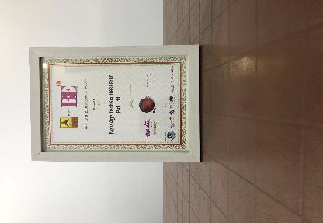
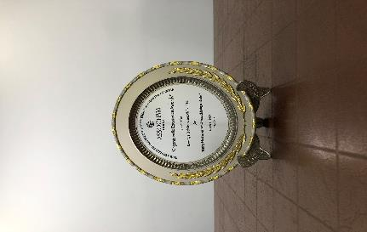

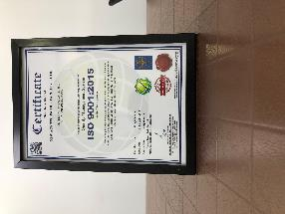

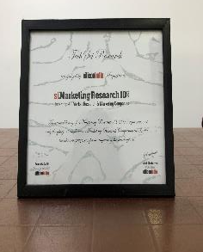


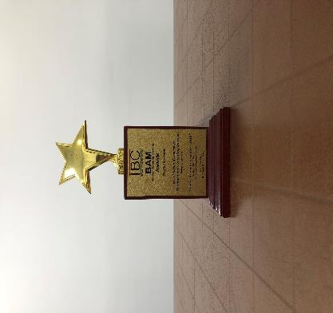
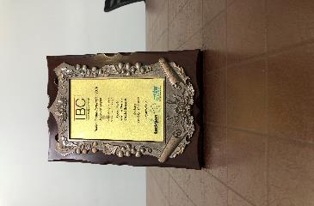
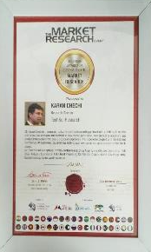
TechSci Research- Awards & Recognition
Best Application of Research Award at World Marketing Congress by ABP News ( 2018 )
Organic India Excellence Awards by ASSOCHAM India (2018)
Business-to-Business Research Award at Brand Excellence Awards by ABP News (2018)
Quality Management System by ISO (2018)
Best Application of Research Award at World Marketing Congress by ABP News ( 2017 )
Award for Best Place to Work in Research at World Marketing Congress by ABP News (2017)
Recognition from Silicon India Magazine
Recognition & Appreciation from WQIA
Best Market Research & Management Consulting Manufacturing Processby Wafisilpa Entertainments
Leadership Award from World Marketing Congress
Leadership Award from World Marketing Congress

Slide 64





























Our Prestigious Clients Who Bought Reports in Chemical Industry

Slide 65

About Us & Disclaimer
TechSci Research is a global market research and consulting company with offices in the US, UK and India. TechSci Research provides market research reports in number of areas to organizations. The company uses innovative business models that focus on improving productivity, while ensuring creation of high-quality reports. The proprietary forecasting models use various analyses of both industry-specific and macroeconomic variables on a state-by-state basis to produce a unique ‘bottom-up’ model of a country, regional and global industry prospects. Combined with the detailed analysis of company activity and industry trends, the result is a uniquely rich evaluation of the opportunities available in the market.
Related Reports
Global Aerospace Plastics Market By Polymer Type (Polyetheretherketone (PEEK), Polyphenyl Sulphide (PPS), Polycarbonate (PC), Acrylonitrile Butadiene Styrene (ABS), Polymethyl Methacrylate (PMMA), Others), By Aircraft Type (Commercial , Military), By Application ( Cabin Interiors, Flight Deck & Cockpit and Structures), By Region, Competition, Forecast & Opportunities, 2025
Global Aromatics Market By Type (Benzene, Toluene, O-Xylene, P-Xylene, Others), By Application (Solvent v/s Additive), By End User Industry (Paint & Coatings, Adhesives, Pharmaceuticals, Chemicals, Others), By Region, Competition, Forecast & Opportunities, 2025
TechSci Research – North America
708 Third Avenue, Manhattan,
New York, United States
Tel: +1- 646- 360- 1656
Email: sales@techsciresearch.com www.techsciresearch.com
TechSci Research – Europe
54, Old brook, Bretton,
Peterborough,
United Kingdom
Email: sales@techsciresearch.com www.techsciresearch.com
TechSci Research – Asia-Pacific
B – 44, Sector – 57, Noida, National Capital Region, U.P. - India
Tel: +91-120-4523900
Email: sales@techsciresearch.com www.techsciresearch.com
Disclaimer
The contents of this report are based on information generally available to the public from sources believed to be reliable. No representation is made that it is timely, accurate or complete. TechSci Research has taken due care and caution in compilation of data as this has been obtained from various sources including which it considers reliable and firsthand. However, TechSci Research does not guarantee the accuracy, adequacy or completeness of any information and it is not responsible for any errors or omissions or for the results obtained from the use of such information and especially states that it has no financial liability whatsoever to the subscribers / users of this report. The information herein, together with all estimates and forecasts, can change without notice. All the figures provided in this document are indicative of relative market Share and are strictly for client’s internal consumption. Usage of the same for purpose other than internal will require prior approval of TechSci Research.

